Slide 1

Power Utilities & Renewables Capabilities Deck
Deloitte Touché Tohmatsu India LLP, January 2025

Slide 2

Contents
1| Industry Overview
2| Our Offerings
3| Our Assets & Accelerators
4| Our Alliances
5| Eminence & Thought Leadership
6| Key Credentials
7| Case Studies
8| Partner Profiles

Slide 3
| Industry Overview
The global power sector is evolving rapidly, driven by renewable energy adoption, digitalization, decarbonization, grid modernization, energy storage, and policy shifts towards sustainable and resilient energy systems

Slide 4
Utility of Future
1
Industry Overview
2
3
4
5
6
7
8
Digitalization is essential component for measuring and sustaining the transformation journey. The technical partner will help in achieving a ‘radical’ redefinition of the utility operating model - from ‘passive’ to ‘intelligent’ assets
Real time reporting
Assets
Customers
Work
(People, Enterprise)
Anytime/Anywhere access of critical information
Legacy
Residential consumers
Commercial consumers
Evolving
Smart generation with advanced monitoring and controls
Advanced inter-connected solutions and self-service
HR
IT-OT convergence
FINANCE
IT
Smart transmission and distribution
Automation of manual functions and activities and enhanced user experience and productivity
Standardized and consistent document management
Sensor and data communication network
Generation
The Future Grid
Customer
Digital Organization
Data Management Consistency
Generation will evolve toward a more diverse and decentralized network of lower capacity, more flexible units with the intelligence to self-operate and self-diagnosis – they will be enabled by network of sensors and automated controls that increase availability, efficiency and demand responsiveness
The future grid will be a communications-enabled self-healing network, able to increasingly act as a balancing entity - seamlessly managing two- way power flows, complex demand management/response and asset health that dramatically reduces asset intensity and operating costs while increasing reliability
Utilities will enhance their relationship with and knowledge of their customers by implementing advanced customer self service, mobile applications, data analytics, communication, and energy management solutions
The utility will be a digitally-enabled shared services organization that will provide fully automated and integrated corporate services, predictive analytics and forecasting, will utilize robotics to minimize manual intervention and optimize headcount, and will elevate user experience, productivity and collaboration – enabled by a digitally-oriented structure, workforce, workplace and culture
Data driven decision making
Mature governance and security requirements

Slide 5

Key “Megatrends” shaping up the energy sector
1
Industry Overview
2
3
4
5
6
7
8
PU&R companies are focusing on addressing the rising environmental, operational, and social challenges
Energy transition and sustainable energy solutions
RE adjacencies and new technologies
Energy transition and sustainable energy solutions
Rise of Digital Technologies
Rise of value-added services
Key implications on the sector
Increasing clean energy mix in the energy portfolio
Emergence of Storage as a balancing component – ”Storage as a Service”
Digitalization of utilities - Load and generation forecasting; grid modernization; intelligent equipment
Customers are becoming aware and demanding
Increasing need for balancing power – need of peaking stations, Storage
Emergence of new EV led business models
Emergence of Connected and Smart Devices
Business are moving towards service-based models
Increasing preference towards RE from corporate players
Focus towards “Hard to abate” sectors; emergence of Green Hydrogen as a decarbonization agent
Increasing adoption of Data analytic for performance monitoring, asset management etc.
Evolution of new features leading to convenience
Utilities can identify and evaluate opportunities against this backdrop to emerge as a Digital Utility of Tomorrow with customer at the center of the business model

Slide 6

Power & Utilities Practice in India
1
Industry Overview
2
3
4
5
6
7
8
Power, Utilities & Renewables team in India has an excellent mix of skill-sets working across the value chain
More than 400 professionals spread across 13 cities in India
Significant experience in the energy sector with focus on policy reviews, regulatory assistance, development of business/ strategic plans for various departments and public sector organizations
Excellent mix of expertise with energy economics, technical, commercial, accounting, financial modeling
The team has worked extensively across all sub-sectors including generation transmission distribution sector.
Armenia
Georgia
Azerbaijan
Kazakhstan
Mongolia
Uzbekistan
Kyrgyzstan
North Korea
Strategic Planning & Restructuring
Turkey
Syria
Turkmenistan
Tajikistan
South Korea
Tunisia
Cyprus
Lebanon
Iraq
Iran
Afghanistan
China
Japan
Morocco
Palestinian Territory
Kuwait
Nepal
Canary Islands
Israel
Qatar
Pakistan
Renewable Energy & Sustainable Solutions
Algeria
Libya
Jordan
Saudi Arabia
UAE
Western Sahara
Egypt
Oman
India
Myanmar
Laos
Power
&
Utilities
Mauritania
Mali
Niger
Eritrea
Yemen
Bangladesh
Thailand
Vietnam
Philippines
Senegal
Chad
North Sudan
Brunei Darussalam
Gambia
Burkina
Djibouti
Operations Transformation
Guinea Bissau
Guinea
Ivory Coast
Ghana
Benin
Nigeria
Ethiopia
Somalia
Cambodia
With primarily focus on India and South Asia, Deloitte India is also working with multiple member firms in Africa, Southeast Asia, and Middle East
Sierra Leone
Liberia
Togo
Cameroon
Central African Republic
South Sudan
Sri Lanka
Malaysia
Equatorial Guinea
Congo Republic
Uganda
Kenya
Singapore
Sao Tome & Principe
Gabon
Democratic Republic of the Congo
Rwanda
Indonesia
Burundi
Tanzania
Digital Transformation
Angola
Zambia
Malawi
Comoros
Namibia
Zimbabwe
Timor-Leste
Botswana
Mozambique
Madagascar
Advisory Services, Policies & Regulations
Swaziland
South Africa
Lesotho

Slide 7
| Our Offerings
Our unique value proposition in power sector is that we focus on helping leaders to address critical issues and challenges impacting government or country performance, economic competitiveness and citizen service

Slide 8





Categorization of Power & Utility Offerings
1
2
Our Offerings
3
4
5
6
7
8
We focus to address critical challenges impacting country performance, economic competitiveness, and citizen service
Power Distribution Management
Operations Transformation
Network Studies & Advisory Services
Sector Restructuring & Project Management
Strategic Planning & Restructuring
Transaction Advisory Services & Due Diligence
Support to Government, Regulatory Commission, Private Entities & Government Utilities
Services in Power & Utilities
Advisory Services, Policies & Regulations
Green Hydrogen, Climate Change & Energy Efficiency Solutions
Energy Transition
Renewable Energy Solutions
Integrated Resource Planning
Digital Transformation
Aveva PI
Network Digitization & Implementation Support

Slide 9

Our Offerings
1
2
Our Offerings
3
4
5
6
7
8
[1/3]
Operations Transformation |Network Studies & Advisory Services
Power Distribution Management
Network Studies & Advisory Services
Sector Restructuring & Project Management
Transaction Advisory Services & Due Diligence
DISCOM financial health analysis reviewing payment cycle, credit rating of off-taker and power procurement
Analysis of tariff profile of DISCOMs and ACS-ARR gap
Distribution loss trajectory & regulatory targets and overall sector assessment
Analysis of competition and procurement strategy adopted by large strategic players
Bid strategy walk in and walk out tariff
Demand and supply assessment
Estimation of peak demand requirements
Fuel supply arrangement
Power Evacuation and Off-take arrangement
Transmission Network Planning
Advisory services for License
Business expansion plans
Demand-supply gap mgmt.​
Growth of supply capacity​
Generation Mix Diversification​
Setting up of new entities​
Restructuring of existing utilities​
Financial Viability Plan & Financing Facility Development​
Integrated Planning​
Transaction and PPP​
Utility Unbundling & Formation of New Utilities​
Business Planning & Process Re-engineering​
Market Assessment​
Operating Model Development​
Transaction Advisory Services and bid process management
Analysis of transaction structure and review of transaction documents
Structuring PPPs & Commercial Contracting for developmental projects
Project assessment for CUF, status of approvals, review of PPA, EPC agreement, O&M agreement, insurance contract, etc.
Technical, commercial & financial due diligence​

Slide 10
Our Offerings
1
2
Our Offerings
3
4
5
6
7
8
[2/3]
Advisory Services, Policies & Regulations | Renewable Energy & Sustainable Solutions
Support to Government, Regulatory Commission, Private Entities & Government Utilities
Green Hydrogen, Climate Change & Energy Efficiency Solutions
Renewable Energy Solutions
Renewable Energy Policy​
PPP Policy​
IPP Policy​
Energy Security Policy​
ICT Policy​
Restructuring Policy​
Cross Border Power Trade
Business Plan, Petition Filing support, Tariff Orders and other regulatory support
Business Expansion & Regulatory Framework Evaluation​
National, state and local level sector reforms
Energy cost optimization and project implementation​
Energy Efficiency benchmarking​
Demand assessment of hydrogen for industrial use in identified industrial areas/ clusters/ industry(s)
Decarbonization potential estimation, pathway definition to accelerate decarbonization of transport
Mapping out the current financing flows around energy transitions
Potential pathways to accelerate the decarbonization of transport
​
Project management support for implementing state action plan on climate change
RE competitive landscape and market based economic dispatch
Energy transition and interstate network study to identify gaps with regards to upcoming RE generation capacity
Evaluation of options like buying renewable energy certificates, self-consumption
Procurement and management of RE power from IPPs
Generation optimization and demand forecasting tool

Slide 11
Our Offerings
1
2
Our Offerings
3
4
5
6
7
8
[3/3]
Digital Transformation
Power Procurement planning through a least cost integrated resource planning model
Capacity Expansion, economic dispatch and power flow modeling:
Integrated Resource Planning along with Economic Dispatch
Assessing power procurement of past years in terms of performance of costs
Assess the power procurement needs over the future years using an Integrated Resource Planning model.
Different scenarios to understand demand scenarios; assess the sources of power procurement (short-term, medium term, long-term PPAs, bilateral contracts, exchanges, etc.)
Support in Preparation of Automated Management Dashboard
Network Digitization & Implementation Support
AVEVA PI
Integrated Resource Planning
Digital Platform Play
Digital Transformation of Utilities
Evaluation of IT infrastructure & implementation support of ERP systems
Conducting a Digital Maturity Assessment of the client's organization to understand the challenges in implementation of Digital Initiatives
Prioritization of challenges and identification of key digital initiatives along with certain all pervasive foundational capabilities like document management system, integration platforms, visualization platform etc.
Forecast possible deployment levels for various future technology-scenarios & fuel charges
Assistance for identification of tools for lowering faults and reducing time for fault correction by use of IT/OT tools
Data acquisition, control & real time visibility. Data aggregation across multiple SCADA/DCS/sites.
Historical data & storage efficiency
Advanced analytics, notifications, event triggers, third party application integration options for prescriptive, predictive and preventive maintenance
Generator performance & optimization. Performance analysis across turbines.
Wind turbines’ performance monitoring & optimization
Fuel efficiency optimization for gas turbines
Transformer health monitoring & alerting
Smart meter data management (MDM) and CIS integration

Slide 12
| Our Assets & Accelerators
Deloitte team has tailored tools to effectively tackle the critical challenges faced by the client

Slide 13
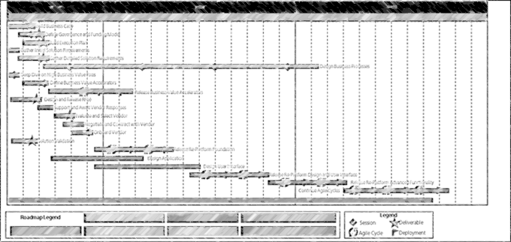
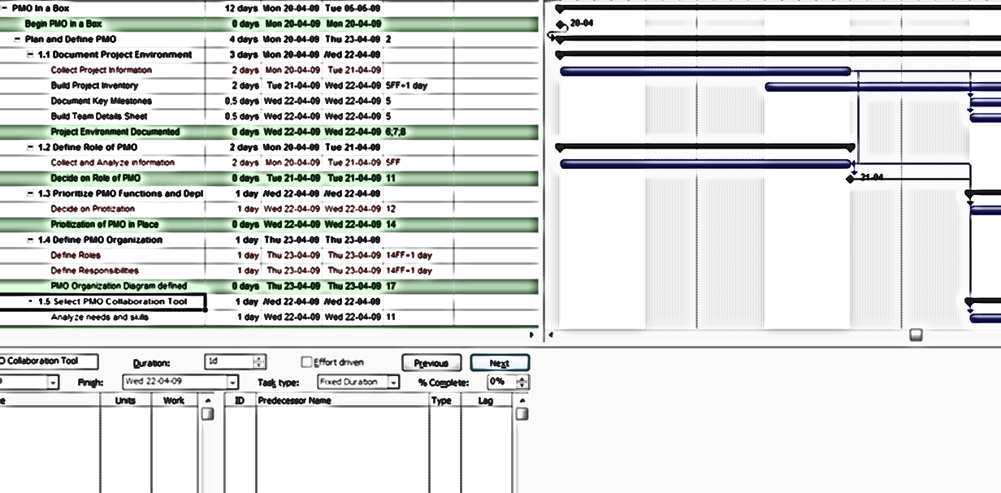
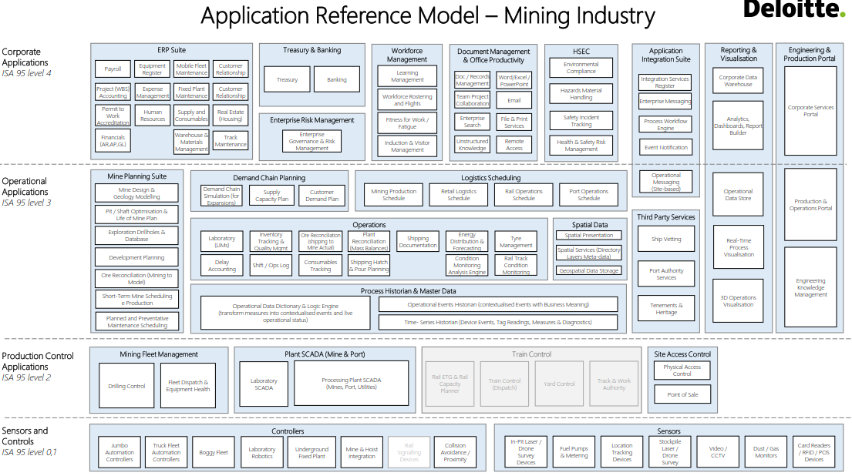
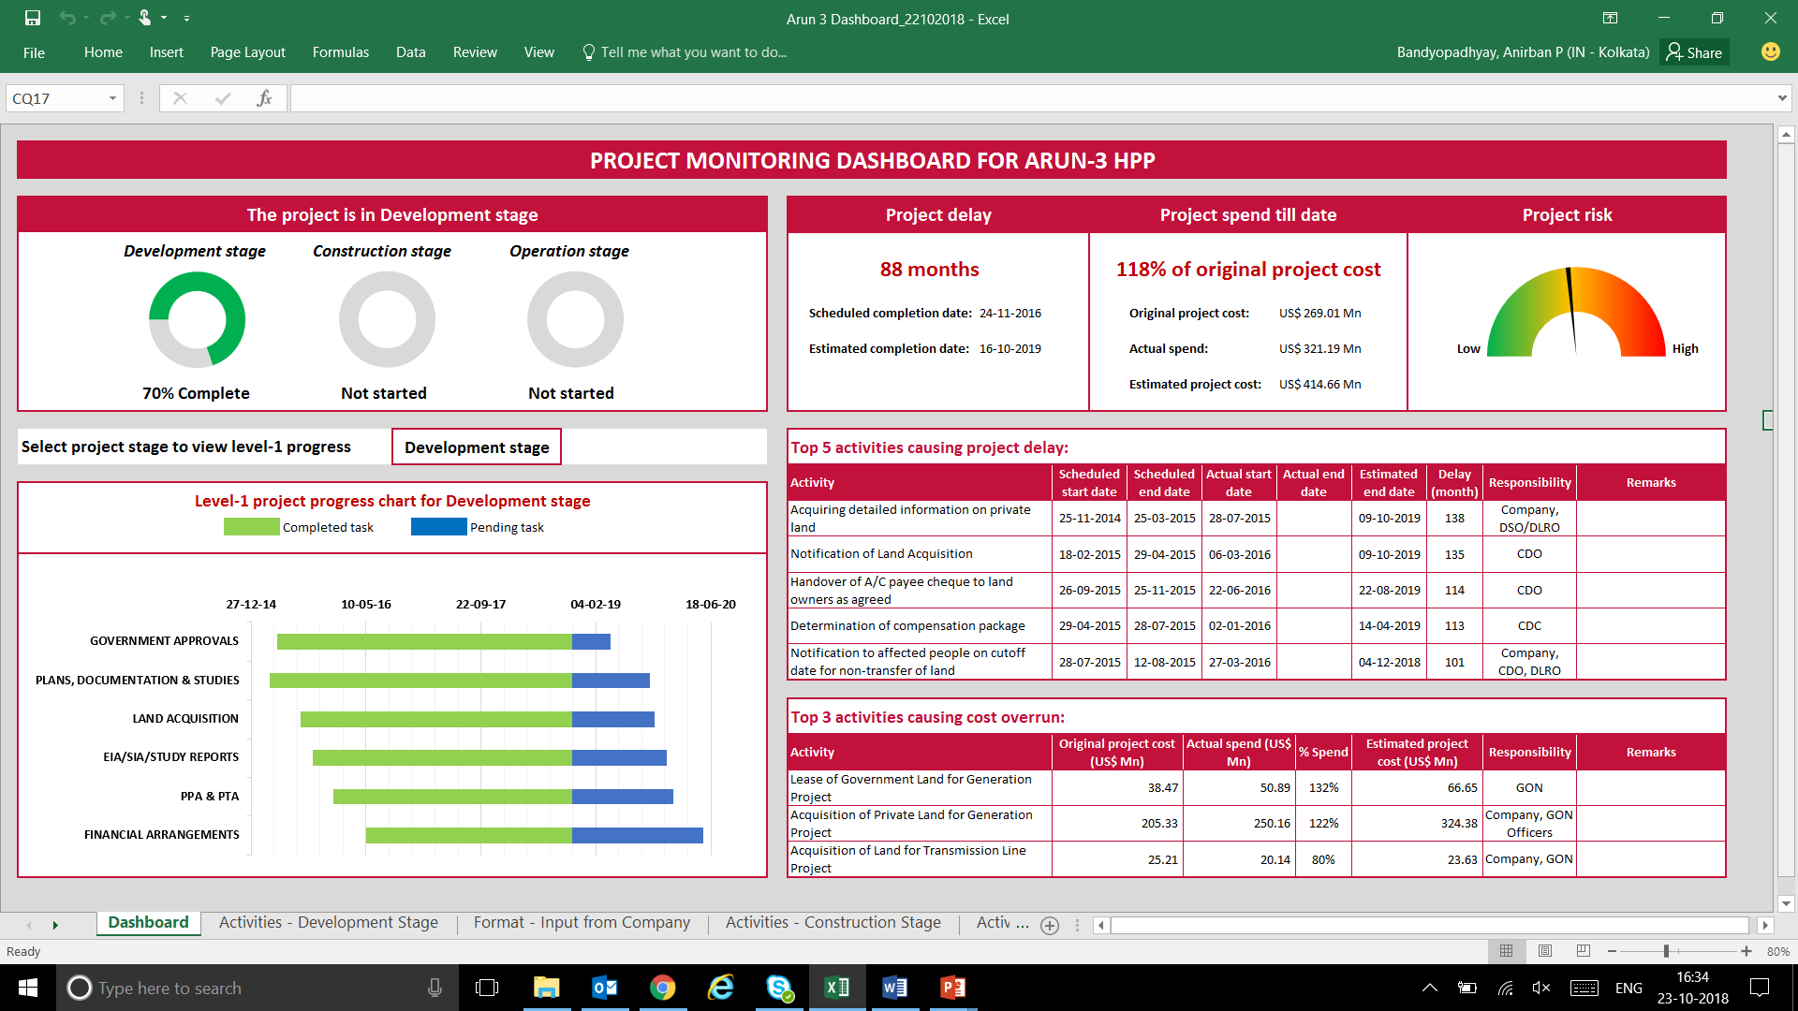
Service Offerings & Proprietary Tools [1/3]
1
2
3
Our Assets and Accelerators
4
5
6
7
8
Project and Program management
Our Service Offerings
Our Proprietary Tools
Project
Scheduling Framework
Costs and cash flow
tracking and
monitoring system
Risk Assessment & Mitigation Framework
1. Setting Up Unit
2. Operationalizing the Unit
3. Project Management & Monitoring
Stakeholder interface management framework
MIS and Project Process
Reporting
4. Stakeholder Management
5. Reporting & Course Correction

Slide 14

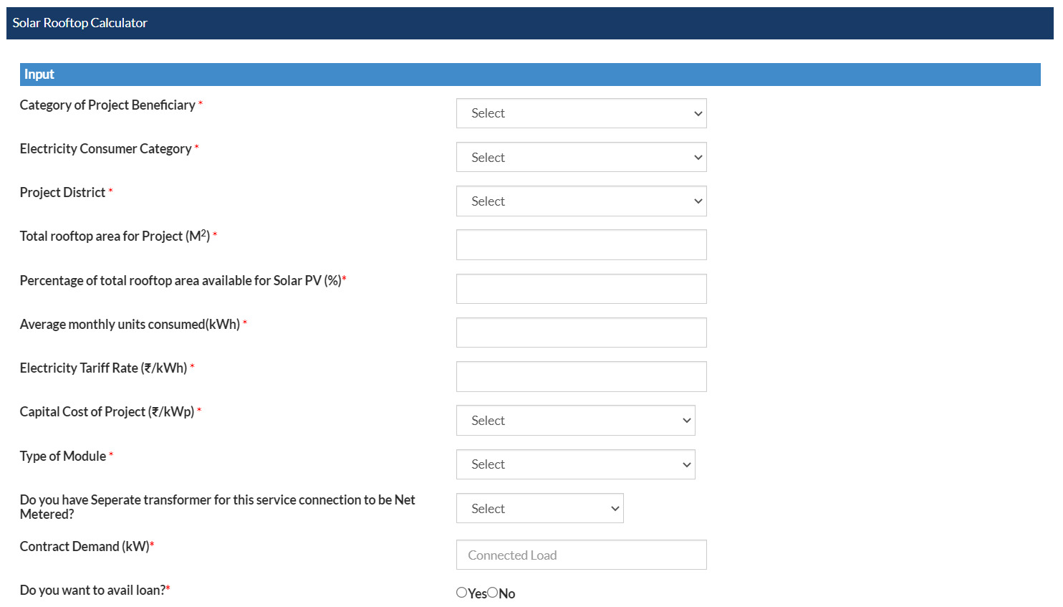
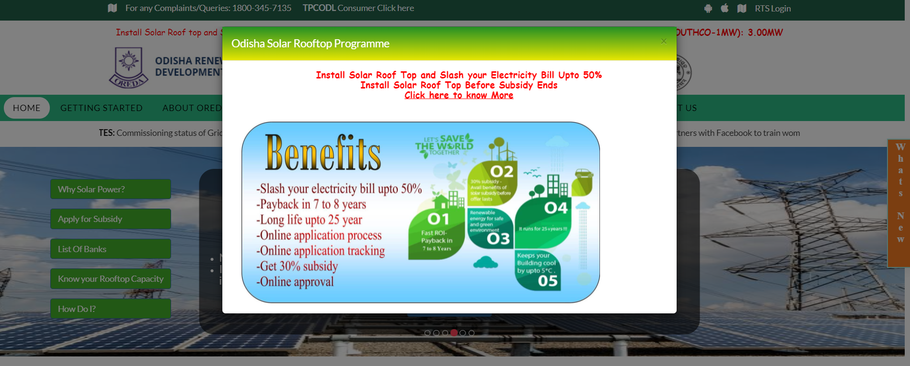
Service Offerings & Proprietary Tools [2/3]
1
2
3
Our Assets and Accelerators
4
5
6
7
8
Managing large scale programs & utility solutions
Our Service Offerings
Our Proprietary Tools
Web Portal for Proliferation of
rooftop solar solutions in Odisha
Growth strategy, feasibility assessment, market assessment, competition assessment, etc.
Project Management in managing capital projects
Due Diligence & transaction advisory
Tool for managing
large scale programs
Rural electrification
Contracting and Bid management
Future of Energy/New market strategy – C&I, Hydrogen, RE Integration, etc.

Slide 15
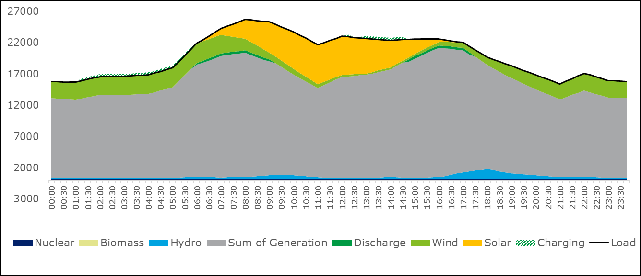
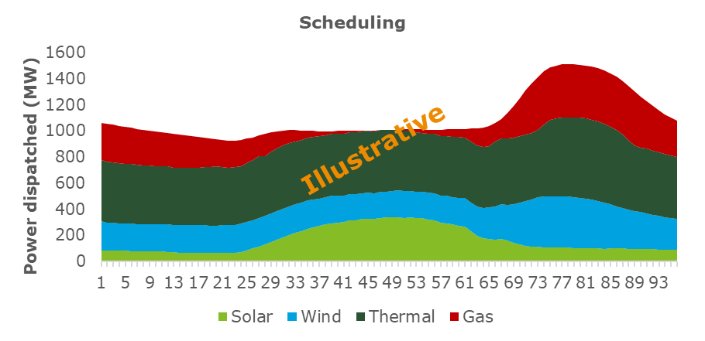
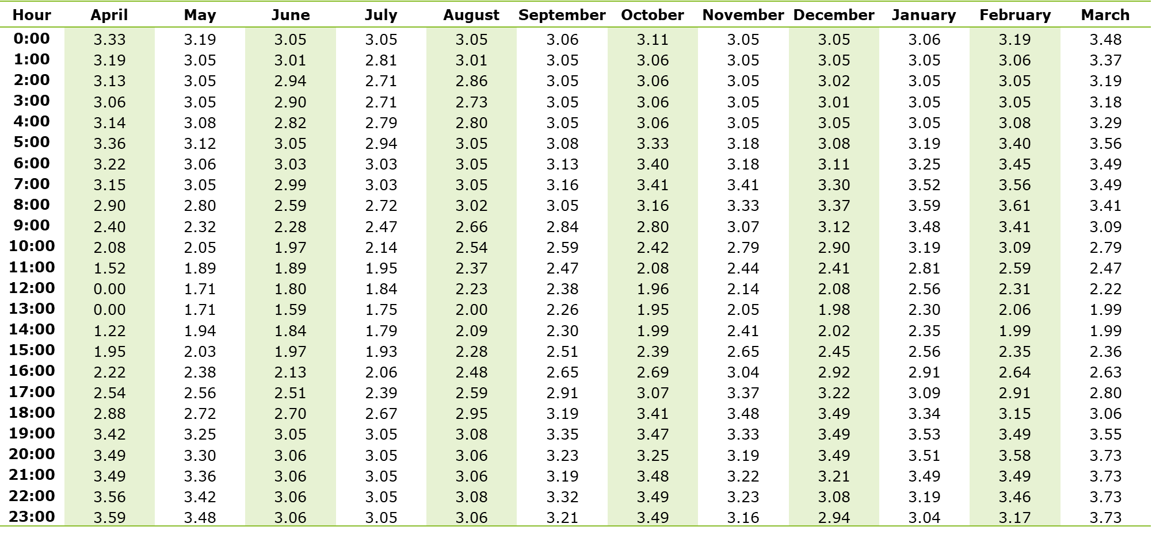
Service Offerings & Proprietary Tools [3/3]
1
2
3
Our Assets and Accelerators
4
5
6
7
8
Value Analyzer, Forecasting & Scheduling Tool and Exchange Price Simulator
Our Service Offerings
Our Proprietary Tools
Battery Energy Storage Solution (BESS)
The Future Grid
D. VAST
D. FAST
D. EPS
Benefits modelling and simulation of ESS value streams
Contractual framework and diligence for ESS as service
Technology assessment
Market and feasibility assessment
Standards and testing framework
Regulation and policies
Communications-enabled self-healing network
Advanced metering infrastructure including smart meters
IT/OT Design and Implementation
Real time balancing of intermittent sources of supply
Drone assisted monitoring
Value Analyser for Storage Technologies
Forecasting and Scheduling Tool
Exchange Price simulator
Python based open source platform for assessing value proposition and benefits of Battery energy storage systems in power system
ML based demand forecasting and production cost based optimal energy scheduling
Simulation of power exchange prices into the future
Hydrogen Fuel
Power Market Optimization Studies
Demand Assessment and Diversification Strategy
Business Model Design
Feasibility Assessment & assistance in Pilot Implementation studies
Commercial Due Diligence and Financial Structuring for investment mobility
Sourcing Strategy
Energy Flow Modelling
Value Analyser for Storage Technologies
ML based demand forecasting, and production cost based optimal energy scheduling
Simulation of power exchange prices into the future
Scheduling, Accounting & Metering and Transaction Settlement Simulations
Distribution Utilities
Planning Agencies
System Operator / LDCs
BESS/ RE Developers / Operators, IPPs,
Distribution Utilities
Planning Agencies
System Operator / LDCs
BESS/ RE Developers / Operators, IPPs,
Power Exchanges
Sellers
Buyers
Investors/ Lending Institutions
Assess future variations in short term prices in power exchange considering high RE penetration;
Decision making for buyers and sellers;
RE curtailment situations and scenario analysis
Analysing economic feasibility for BESS including optimum sizing and siting; Integrating more Renewable energy into the grid
Undertake cost optimal energy scheduling;
Understand new generation capacity and network expansion needs

Slide 16
| Our Alliances
Deloitte and its alliance partners have collaborated to create a diverse array of custom-made solutions that address the unique demands of prominent organizations, including those at the forefront of pioneering business strategies.

Slide 17






Our Alliances
1
2
3
4
Our Alliances
5
6
7
8
Deloitte is a globally recognized leader in enterprise digital transformation through successful collaborations with major alliances
Collective experience
Deloitte is the leader in enterprise digital transformation. We have the collective wisdom, knowledge, and experience from our global practitioners, having successfully multiple assignments with our alliances such as SAP, Microsoft Azure, Oracle, AWS, Salesforce, Google Cloud etc.
Size, breadth, and global reach of services
We have the breadth and depth of service capabilities across consulting, advisory, implementation, and application management services. We offer end-to-end services inclusive of cybersecurity, tax, global mobility, payroll outsourcing, and development of business processes.
Business transformation and quality leader
A leader in the digital ecosystem for global, complex transformation projects with proven solutions and methodologies, we have been recognized by analysts consistently as leader business transformations of Public Utilities & Industries.
Industry knowledge and accelerators
Deloitte develops product implementation accelerators to enable our clients’ enterprise digital transformation and deliver faster impact to value. Deloitte AscendTM is a digital transformation platform designed to help you reimagine your processes, accelerate implementation, and maximize value of your Cloud investment with our industry leading solutions, innovation, and automation.
Blended global delivery model and usage
We have one of the largest ecosystems of certified delivery center practitioners in India with regional hubs in the different countries. Our dedicated team and delivery centers enable coverage around the clock to meet our clients’ needs.

Slide 18
Overview of AWS & Oracle Capabilities
1
2
3
4
Our Alliances
5
6
7
8
Deloitte offers solutions which helps businesses to leverage the cloud to respond to disruptions and achieve growth
AWS Capabilities
Oracle Capabilities
Application migration and modernization
Modernization of applications to reduce operational costs and innovate in impactful ways for a sustainable future.
SAP on AWS
Transform business with cloud to respond to nonstop disruption and growth of the business – from strategic design to seamless execution to ongoing operations.
Electronic Health Records on AWS
Unlock value from the cloud with the Deloitte-AWS electronic health records (EHR) solution on AWS.
Data analytics and AI/ML
Optimize data strategy and choose the right cloud analytics and AI/ML approach to realize additional value from data.
Analytics
Drive performance value through powerful analytics environments that transform how business decisions are made.
Cloud engineering
Deploy the latest cloud and server-less technologies to reduce development and operational costs and lay the foundation for advanced machine learning.
Operate
Provide end-to-end, turnkey, 24x7 services for both legacy and cloud environments. Monitor, upgrade, patch and resolve critical system issues to go beyond the traditional “keeping the lights on” approach.
Supply chain
Drive the shift from linear supply chain operations to an interconnected, open system that drives integrated business strategy for operational excellence.
Industry vertical solutions
Deloitte’s extensive experience within and across industries allows us to bring proven insights and help accelerate progress toward your goals leveraging the AWS cloud.
Tailored customer experiences via Amazon Connect
Amazon Connect and AI help evolve customers’ contact center experiences with state-of-the-art technology that provides a true 360-degree view of customers.
Enterprise performance management
Standardize global financial processes to improve efficiency and consistency, while allowing finance organizations to spend more time on strategic scenario planning and data analysis
Customer experience
Make “creative digital consultancy” real and in doing so, transform CX operations into modern, data-driven, creatively focused marvels and make new markets.

Slide 19
Overview of SAP Capabilities in India
1
2
3
4
Our Alliances
5
6
7
8
We are a recognized leader globally by independent analysts in S/4HANA application services, systems integration and business analytics consulting. We are also recognized leader in CRM and customer experience implementation services
Analytics
SAP S/4 HANA Analytics
SAP BI-Business Objects
SAP HANA Cloud Platform / IOT
Industries
Initiatives
SAP Big Data and EnterpriseScience
SAP Managed Analytics
Consumer
Low code test Automation
Finance
Supply Chain
Customer/ Sales & Ops
Cross Industry
CICD Tech Platform
Core Finance
S/4HANA Logistics
Customer and Order Mgmt.
Oil and Gas, Utilities
Expanding Factory Set ups
Central Finance
Demand Driven
Supply Chain
Hybris
Financial services
Talent Development
Enterprise Performance Management (EPM)
Ariba
Converged Billing
Life sciences
Delivery Excellence (CMT)
Integrated Business Planning
Pricing Management
Public Services
Manufacturing &
Asset Mgmt.
Revenue Management
Tech. Media, Telco
Service Parts Mgmt.
SAP Business Technology Platform
DB and Data Management
SAP Integration Suite
SAP Analytics
Intelligent Technologies
SAP Extension Suite

Slide 20
| Eminence & Thought Leadership
Deloitte sets the standard in the utilities industry, delivering exceptional advisory services and driving forward thought leadership initiatives

Slide 21


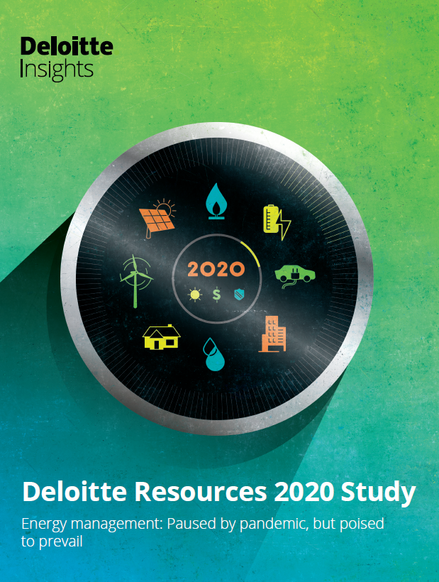


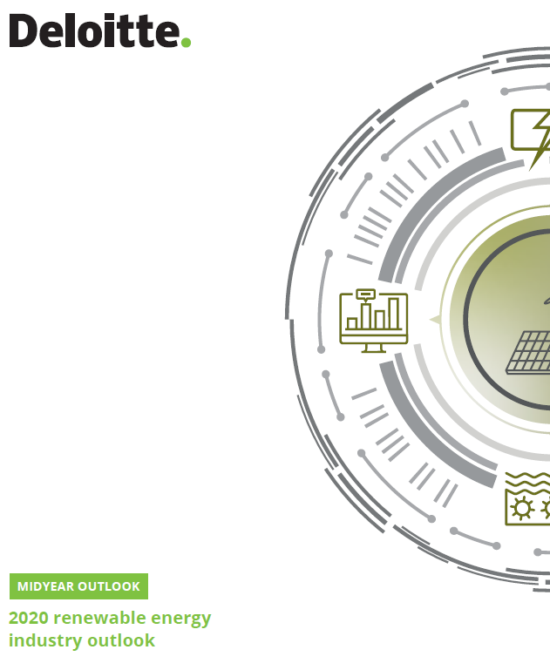
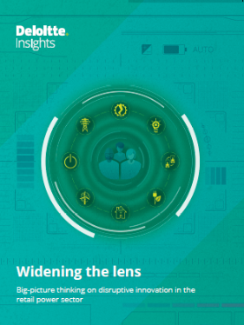
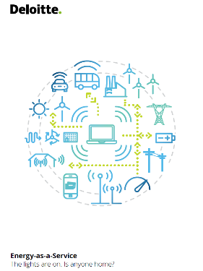
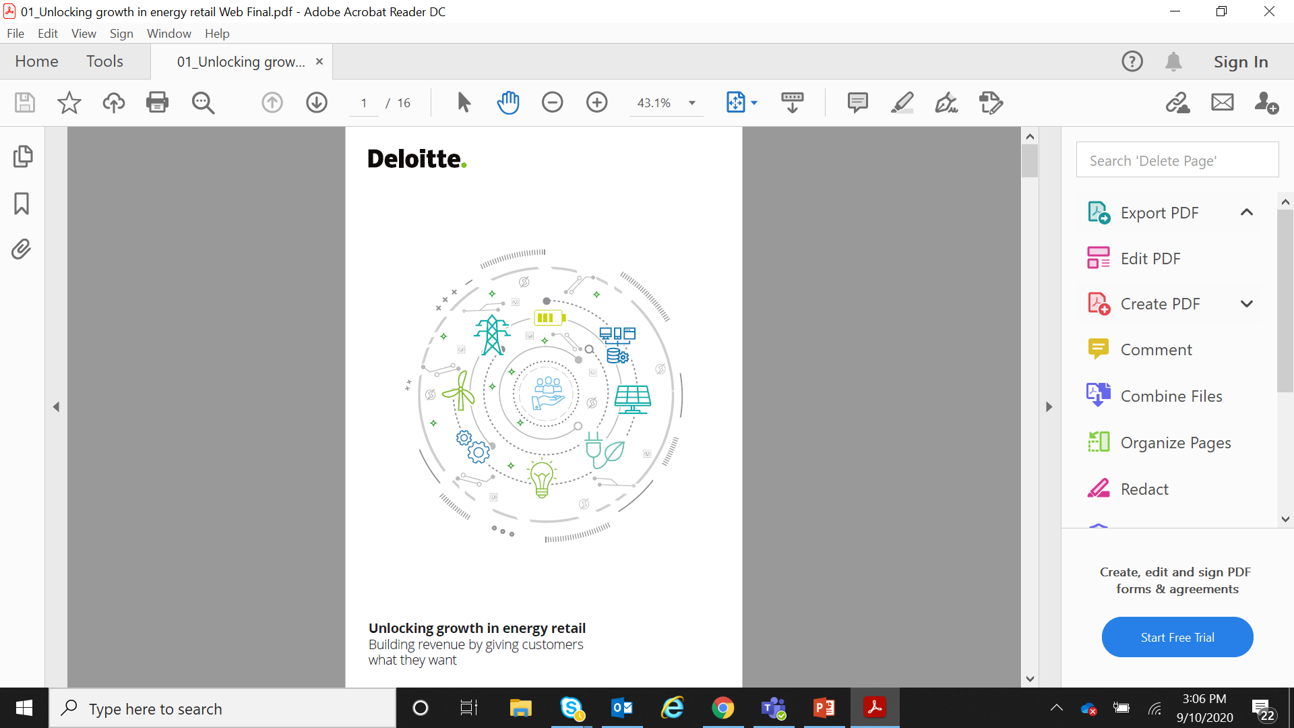
Our Publications in Power & Utilities Sector [1/2]
1
2
3
4
5
Eminence & Thought Leadership
6
7
8
Deloitte is at the forefront of Advisory and Thought Leadership in the utilities industry
A Market Approach for Valuing Offshore Wind Farm Assets
Our analysis of offshore wind farm transactions have led to the conclusion that installed capacity, capacity under construction and capacity in late-stage pipeline affect the enterprise value of transactions.
Energy management: Paused by pandemic, but poised to prevail - Deloitte Resources 2020 Study
With the COVID-19 pandemic sending the economy into recession, energy and resource use by US businesses and residential consumers are bound to be affected.
Power & Utilities Sector Evolution Unlocking Value through M&A
This report covers key areas acquirers should look at when embarking on a M&A activity.
Powering the future of mobility
The report takes a look at the sales of electric vehicles globally and analyzes how utilities can promote and prepare for increased EV adoption.
Managing Variable and Distributed Energy Resources
This article discusses dispatchable Distributed Energy Resources (DER) as a solution to manage wind and solar variability.
2020 Renewable Energy Industry Outlook: A midyear update
Our midyear 2020 renewable energy industry outlook explores major trends and what it means for companies in the industry.
Widening the Lens: Big-Picture Thinking on Disruptive Innovation in the Retail Power Sector
This report shares how some companies are disrupting the retail power sector by innovating across the business.
Energy-as-a-Service
The lights are on. Is anyone home?
This report studies the deployment of distributed generation, adoption of new technologies, installation of utility scale storage in the utilities landscape
Unlocking Growth in Energy Retail: Building Revenue by Giving Customers What They Want
This report provides insights into how retail energy providers can overcome challenges and unlock growth

Slide 22








Our Publications in Power & Utilities Sector [2/2]
1
2
3
4
5
Eminence & Thought Leadership
6
7
8
Deloitte is at the forefront of Advisory and Thought Leadership in the utilities industry
The natural gas utility workforce in a decarbonizing world
Explore how can natural gas utilities and their workforces prepare for sustainability, growth, and bridge the workforce gap?
The future of Power: European Utility Scenarios
The energy industry must commit to growth and investment for a low-carbon future, though the practical outcomes remain uncertain.
The European Hydrogen Economy: Taking Stock and Looking ahead
The EU and other nations aim for significant hydrogen targets by 2030: 10 MtH2 renewable hydrogen and 40 GW electrolyzer capacity.
2023 Power & Utilities Industry Outlook Despite ongoing challenges, our annual industry outlook examines how digital tech, market advancements, and government investment can drive progress in next-gen energy.
Electric power supply chains: Achieving security, sustainability, and resilience
In the past two years, supply chain disruptions impacted industries, including electric power. The sector faced challenges even before pandemic and geopolitical disruptions.
2023 Renewable Energy Industry Outlook
The coming year brings growth opportunities for renewable energy, supported by climate-focused policies, but challenges remain.
European Power & Utilities Newsletter Quarterly updates on the market trends and performance of the European power and utilities sector
PU&R Under the spotlight Sector specific cut for PU&R, based on the wider report, 'From Great Resignation to Great Reimagination'

Slide 23
| Key Credentials
Deloitte has successfully assisted clients across various regions, including the African Corridor and other regions, collaborating with renowned organizations such as USAID, IFC, and ADB

Slide 24








Reforms, Restructuring and Private Sector Participation (1/2)
1
2
3
4
5
6
Eminence & Thought Leadership
7
8
Our Service Offerings and Credentials – Market & Regulatory Reforms
Market and Regulatory Reforms
Tata Power and CDC
USAID, Nepal
Evolving Role of Market Players & Market Reforms
Transaction advisory support for bidding for Distribution asset of EGC Ghana
Nepal Hydropower Development Project – Assistance in establishing the electricity sector regulator in Nepal
Generation
Transmission
Distribution
Retail
Consumers
Fossil
Base-load
One-Way
Provider
Consumers
Amperion Power Distribution
Company Limited
Now
Public Utilities
Commission, Sri Lanka
Future
Renewable
Balancing
Two-Way
Facilitator
Prosumers
Transaction advisory support for Nigeria Power sector privatization
Review and Re-design of Tariff Methodologies and Merit Dispatch Procedures
Zimbabwe Electricity Transmission Distribution Company Limited
Ministry of Power,
Government of India
Policy & Regulatory Reforms
Sectoral Reforms
Policy Review and Development
Increasing Role of Regulator
Statutory, Regulatory & Commercial (PPA&TSA) assistance to ZETDC, Zimbabwe
Privatization of power distribution function of electricity department of Union Territories in India
Setting up of new entities
Restructuring of existing utilities
Financial Viability Plan & Financing Facility Development
Integrated Planning
Transaction and PPP
Renewable Energy Policy
PPP Policy
IPP Policy
Energy Security Policy
ICT Policy
Restructuring Policy
Cross Border Power Trade
Cost Reflective Tariff
Performance-based regulation
Licensing & Market regulation
FiT, Renewable purchase regulation
Open Access, Balancing and settlement
Department of Power, Govt. of West Bengal
International Finance
Corporation
Strategic planning and transformation of the West Bengal power sector
Corporatization of Yangon City Electricity Supply Board
NTPC Education & Research Society / Ministry of Power
USAID
Institutional, Financial and Regulatory Analysis
Stakeholder Consultation
Preparing roadmap for development of Power Market in India and assistance in implementation of the envisaged interventions
Program management support for Implementation of National Open Access Registry under RISE initiative
National Policy & Vision Development
International Benchmark and Peer Reviews

Slide 25







Reforms, Restructuring and Private Sector Participation (2/2)
1
2
3
4
5
6
Eminence & Thought Leadership
7
8
Our Service Offerings and Credentials – Utility Restructuring
Utility Restructuring
ZESCO, Zambia
Zimbabwe Energy
Regulatory Authority
Utility Reforms & Strategy Development
Utility Unbundling & Formation of New Utilities
Business Planning & Process Re-engineering
Market Assessment
Operating Model Development
Developing Business Plan for ZESCO and preparing their financial sustainability plan
Review of the operations and cost structure of ZESA Holdings
Social Objective Management
Growth of electricity access
Affordability of electricity tariff
Increase in per capita electricity consumption
Customer Satisfaction
Improve Consumer focus
Increase service quality & feedback management
Customer Outreach Management
ESKOM, South Africa
Nigeria Electricity
Regulatory Commission
Financial Plan
Financial Viability Planning
Financial Restructuring
Forecasting Model Development
Advisory Support for the Operating Model Review
Strategy formulation & Business plan development for NERC
Technical Performance Improvement
Demand-supply gap mgmt.
Reduction of technical losses
Growth of supply capacity
Generation Mix Diversification
Reliability and quality of electricity supply
Digitization
Smart Grid & Network Management
Utility of Tomorrow Strategy
MIS Strengthening & Business Intelligence
World Bank
Power Cell, Bangladesh
Advanced Metering Infrastructure and Analytics Guidance Study for South Asian Power Distribution Utilities
ICT Roadmap for Bangladesh Power Sector (All Public Utilities)
Commercial Performance Improvement
Rationalization of tariff
Cost Reflective Tarif
Fuel Management
Cost Optimization Strategy
Bid Advisory
Institutional Strengthening
Skill Gap Assessment
Training Plan in line with sectoral evolution & market requirement
Change Management
USAID, Nepal
Market Reforms Unit, India
URJA Nepal – Utility performance & Policies improvement, Advanced energy systems deployment
Institutional Strengthening & Capacity Building of Successor Entities of Jharkhand State Electricity Board, India

Slide 26














Renewable Energy and Decarbonization Initiatives (1/2)
1
2
3
4
5
6
Eminence & Thought Leadership
7
8
Our Service Offerings and Credentials – Renewable Energy
Service Offerings
Ministry of Energy and Power Development, Zimbabwe
Rural Energy Agency
Policy & Regulatory
Market Assessment
Due diligence
Development of a Renewable Energy Policy for Zimbabwe
Development of Renewable Energy Financing Facility in Tanzania
Government of Armenia
United Nations
Development Programme
Bid strategy
RE procurement for
C&I consumers
Strategy &
business plan
Utility Scale Solar Power Project - Transaction Advisory Services in Armenia
Review of Small-Scale Distributed Generation Scheme and Assessing the Solar Photo-voltaic Market Status (Mauritius)
International Finance Corporation
The World Bank
Policy and Regulatory
Market Assessment and Due Diligence
Feasibility studies and business model design for C&I consumers in textile cluster in Bangladesh
Develop & demonstrate private sector led replicable business models for off-grid/ mini-grid electrification in Bihar, India
Tariff and RE policy Design;
Petition Filing support;
REC process;
RPO Strategy
Technical, commercial & financial due diligence
Market and Policy Assessment
Carrying out business plan review and validation
The World Bank
International Finance Corporation
Bid and Procurement Strategy
Strategy and Business Plan
Review of National Solar Mission Phase 1 & 2 Setting up National Solar Energy Technology Centre
Distributed Solar PPP Project (Gujarat and Odisha), Power Policy and Capacity Building Initiatives
Providing bid advisory services
PPP structuring
Financing Strategy
Project Feasibility Assessment
Financing Solution
Preparing an implementation roadmap
ABB India Limited
HCL Technologies Ltd
RE Procurement Strategy to achieve RE100 status
RE100 Procurement Advisory

Slide 27








Renewable Energy and Decarbonization Initiatives (2/2)
1
2
3
4
5
6
Eminence & Thought Leadership
7
8
Our Service Offerings and Credentials – Energy Efficiency
Orchestrating end-to-end success
Federal Electricity and Water
Authority
Asian Development Bank
Clean Coal IPP Advisory Services
Clean Energy and Network Efficiency Project, Sri Lanka
Maldives Energy Authority
World Bank
Preparing Outer Islands for Sustainable Energy Development Project
Greater Male’ Region Renewable Energy Integration Plan
Policy development
Strategy preparation
Project management
Asian Development Bank
ONGC
Climate change mitigation
Building energy efficiency
Promoting Clean Energy Development in Bhutan – F001 Hydropower Pre-Feasibility Study
Advisory Services for Energy Efficiency Improvement
Project management support for implementing state action plan on climate change
Development of market-based mechanisms for states
Energy cost optimization and project implementation
Renewable options
MEDA Maha Urja
GTZ
Consultancy support to MEDA in Green Power Development Fund Structuring
Technology upgradation and Energy Efficiency Improvement project in steel Forging SME cluster in India
Industrial energy efficiency
Utility demand side management
Energy cost optimization and project implementation
PAT facilitation and support
Energy Efficiency benchmarking
Renewable options
Market assessment
Impact assessment and scoping
DSM design and support
Capacity building programme
Ambuja Cements Limited
Shell India
Assistance in preparing RPO strategy roadmap and REC portfolio management
Go and No-go strategy for Shell India in the Power Trading Business

Slide 28



Future of Utility / Emerging Technologies
1
2
3
4
5
6
Eminence & Thought Leadership
7
8
Our Service Offerings and Credentials
Generation
The Future Grid
USAID /
Ministry of Power, GOI
The World Bank
Generation will evolve toward a more diverse and decentralized network of lower capacity, more flexible units with intelligence
The future grid will be a communications-enabled self-healing network, able to increasingly act as a balancing entity
Development and implementation of grid applications – Integration/BESS/EVs
Assess impact of major policy and energy transition disruptive events on a utility in India
Storage and Urban Mobility
Digital Utility
Energy storage is key to enable current energy transition towards electric mobility, integration of cleaner fuels and increase energy access around the world
The utility will be a digitally-enabled shared services organization that will provide fully automated and integrated corporate services
Ministry of Environment and Energy, Maldives
Forum of Regulators, India
Greater Male’ Region Renewable Energy Integration Strategy Plan
Evolving measures for effective implementation of pre-paid metering in the Country
Key Offerings
International Finance
Corporation
USAID, India
Studies to support seamless renewables and DER integration
Benefits modelling and simulation of ESS value streams
Cost efficiency through digital tools
Consumer centric business models
Future of Urban Mobility in India
Electric vehicle Charging Infrastructure and Impacts on Distribution Network
Support seamless communication with consumers
Planning for emerging technologies
The World Bank
Power Cell, Government of Bangladesh
Developing EV ecosystem
Digital & Technology Roadmap
DPR for Smart Grid Deployment in Udaipur Smart City
ICT Roadmap for all the power utilities in Bangladesh

Slide 29
| Case Studies
Deloitte has helped Power Utility client with different

Slide 30


Regulatory Information Management System
1
2
3
4
5
6
7
Case Studies
8
Development and Deployment of a Regulatory Information Management System (RIMS)
Designing and Implementing Regulatory Information Management System (RIMS) for Central Electricity Regulatory Commission (CERC)
The Central Electricity Regulatory Commission (CERC) is a statutory body in India established under the Electricity Regulatory Commissions Act. CERC's key responsibilities include formulating regulations related to tariffs, licensing, and grid operations. Deloitte acted as a Domain Expert and IT Strategy Consultant, the role involved defining information and system requirements, selecting vendors, and overseeing the project's three-phase execution. Responsibilities extended to developing Requirement Specifications, preparing Tender Documents, and actively supporting CERC throughout the tendering process. Successfully managed the RIMS implementation and subsequent 12-month trial operation, showcasing expertise in both the electricity industry and information technology for seamless project development and execution
 | Develop preliminary System Requirements | Defining information requirement, defining the system (software and hardware) requirement, selection of the vendor for development and implementation of RIMS and subsequent support to CERC during implementation of RIMS
 | Development & Digitization | Acting as a Domain Expert and IT Strategy Consultant with in-depth knowledge of both the electricity industry as well as information technology and being responsible for overall development of RIMS
 | System Specification & Procurement | Developing the Requirements Specifications and preparing the Tender Documents for invitation of bids and assisting CERC during the tendering process including negotiations and final selection of the software vendor / developer
 | Implementation of RIMS | Also being responsible for management of the implementation of the RIMS and subsequent trial operation for a period of 12 months
 | Capacity Building & Training | Executing the entire assignment in three phases as outlines by CERC and performs all tasks required for successful implementation of the RIMS and providing Capacity Building and Trainings to the identified resources
Approach
The approach involved a meticulous three-phase strategy, focusing on defining information and system requirements, vendor selection, and comprehensive oversight throughout implementation.
Value Delivered
Tailored Solution: Crafted a Regulatory Information Management System (RIMS) tailored to the unique requirements of CERC
Efficient Vendor Selection: Successful vendor selection through a strategic approach, which involved developing comprehensive tender documents, active involvement in negotiations, and final selection
Key learnings
Balancing Industry and IT Expertise, Stakeholder Collaboration, Strategic Vendor Management, Adaptability in Project Execution

Slide 31




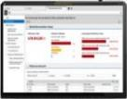




Corporate Management System (CMS)
1
2
3
4
5
6
7
Case Studies
8
Implementation of an Integrated Corporate Management System
Establishment of Corporate Management System for Tanzania Electricity Supply Company
Tanzania Electric Supply Company Limited (TANESCO) is a Tanzanian government-owned parastatal organization founded in 1964. It operates under the complete ownership of the Tanzanian government, and its activities are regulated by the Ministry of Energy and Minerals. Deloitte was contracted by Tanzania National Electric Supply Company Limited to assist in enterprise transformation through implementation of a Corporate-wide Management System aimed to implement a fully integrated Enterprise Resource Planning system (ERP) to enhance ICT delivery towards addressing current and future demands of the business
Quality Assurance Support
Support to client during Testing
Recommendations on areas of improvement
Design for standard functionality
Process Maps
Client Support
Evaluate and enhance SCM, CRM, GRC, and DMS business processes for optimal performance within the CMS framework
Examine documentation to comprehend the current state business processes, conducting gap analyses against best practices and TANESCO requirements
Review system architecture and configuration documents, support User Acceptance Testing (UAT), and guide data preparation and migration activities
Standard Solutions & Industry Best Practices
Comprehend the current digitization and aid transition for future business state
Host workshops, offer power utility process maps for SAP S4HANA implementation
Fit-gap analysis to identify key in-scope processes
S/4HANA preconfigured solution for best practice
Supporting design documentation
Innovation repository
Description Of Services Provided
Conducting comprehensive business and system analysis for TANESCO, including process evaluation, infrastructure recommendations, requirement gathering of standard as well as customized solutions and assistance for strategic system implementation. Coordination of informative site visits and guidance on technology and software aspects, ensuring alignment with TANESCO's objectives
Review and recommend the appropriate technology infrastructure, including Local and Wide Area Network, essential for the successful implementation of selected systems
Provide direction and guidance regarding software requirements to meet TANESCO's needs. Offer expertise in IT Quality Assurance to ensure the reliability and performance of the CMS

Slide 32

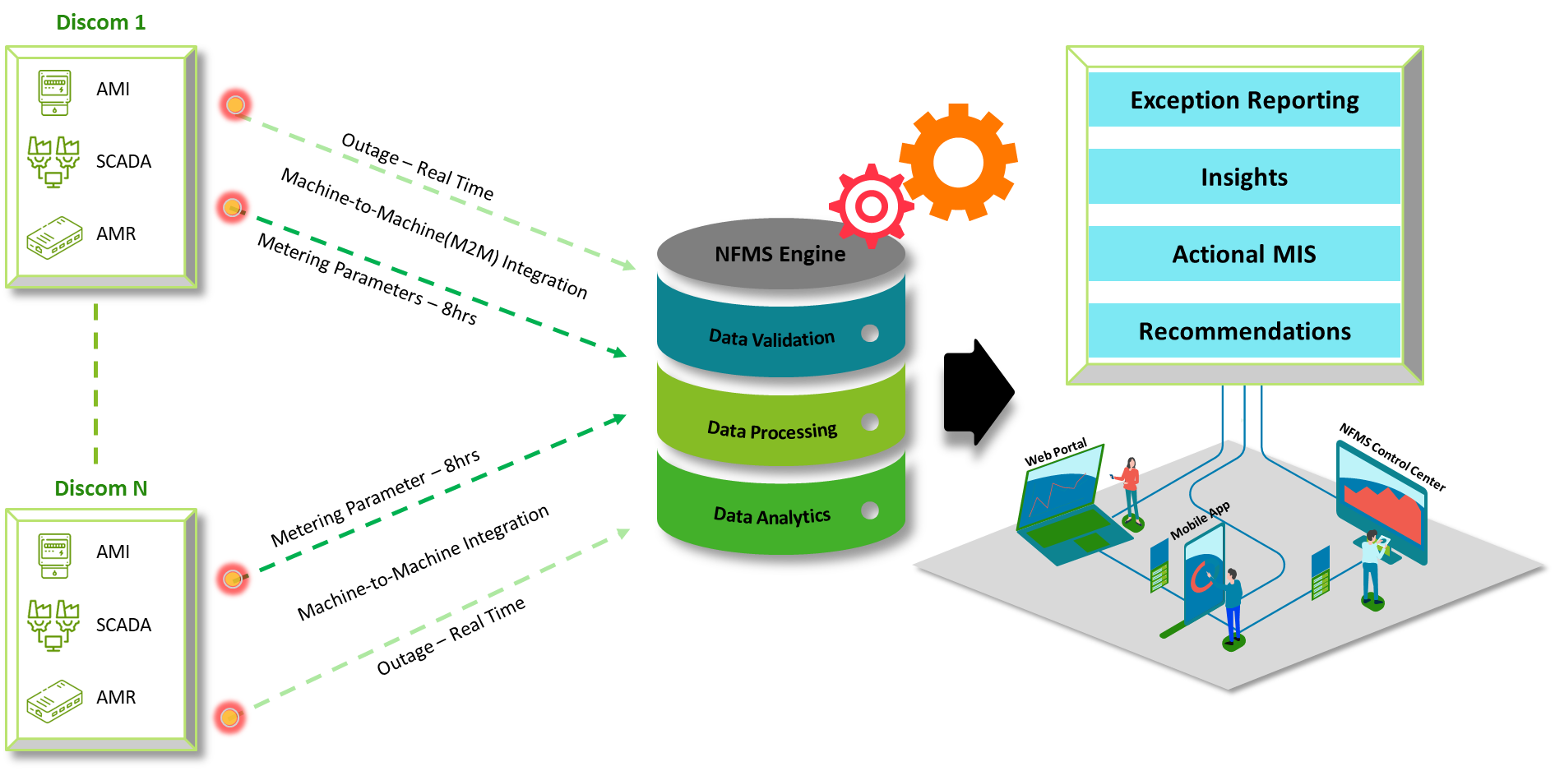
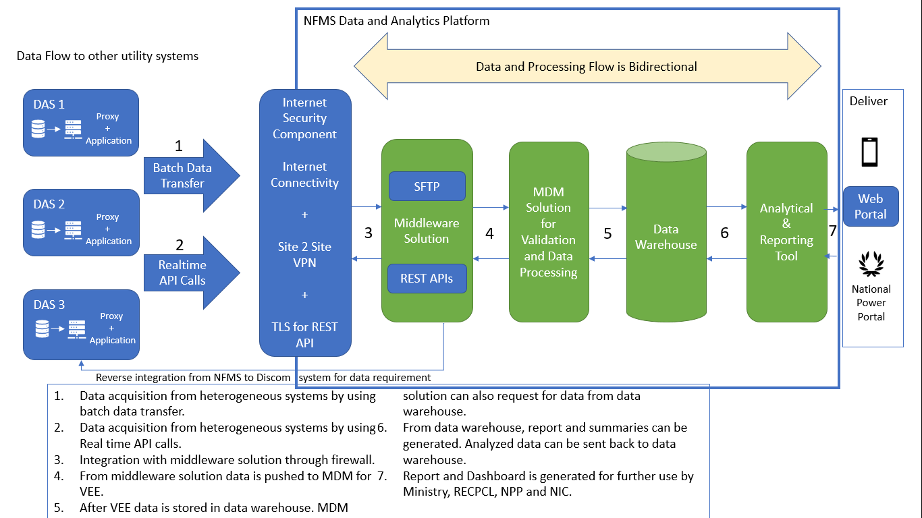
National Feeder Monitoring System for India
1
2
3
4
5
6
7
Case Studies
8
Central IT Solution for Feeder Monitoring and Data Acquisition
Central IT Solution for Feeder Monitoring and Data Acquisition from all Distribution Utilities of India
The project aimed to develop Information Management System that centrally monitors the reliability and quality of power on all distribution feeders across the country through Machine to Machine (M2M) integration. This included real-time and batch integration with various feeder monitoring systems at the Electricity Distribution Level. Additionally, the project involved evaluating the Architecture, Data Analytics framework, reviewing Data Structures in divergent formats from Utilities, and delivering outcomes related to Data Analytics, such as reviewing use cases, relevant algorithms, and user-friendly visualizations. Coordination and guidance on communication issues between Utilities' Data systems and the Central IT solution are integral aspects of the project.
Overview
NFMS Architecture
Deloitte team was responsible for all the activities of the PMU i.e. Co-ordination and monitoring for timely implementation of the project plan & Fortnightly MIS reporting with respect to overall project progress, project milestones and onboarding status for requisite intervention
Preparation of RFP document for onboarding System Integrator
Support to client with Bid Management activities
Evaluation of system architecture
Review of the Data Structure based on divergent formats and data shared by the Utilities
Review Network & Communication framework
Provide insights on the tools and technologies
Review of IT & Cloud framework
Support, monitoring, reporting and follow-up with utilities for data collection, bridge gaps in integration, providing functional support and supporting with best practices
Project Impact & Benefits to Client
Enhanced Monitoring and Coordination - Improved coordination through the centralization of information, enabling timely interventions and adjustments as needed
Optimized Data Analytics - Improved data structures based on diverse utility formats ensured effective utilization of data
Informed Decision-Making - Deliverables related to Data Analytics, including use cases and relevant algorithms, provided valuable insights for informed decision-making. User-friendly visualizations contributed to a clearer understanding of project dynamics

Slide 33

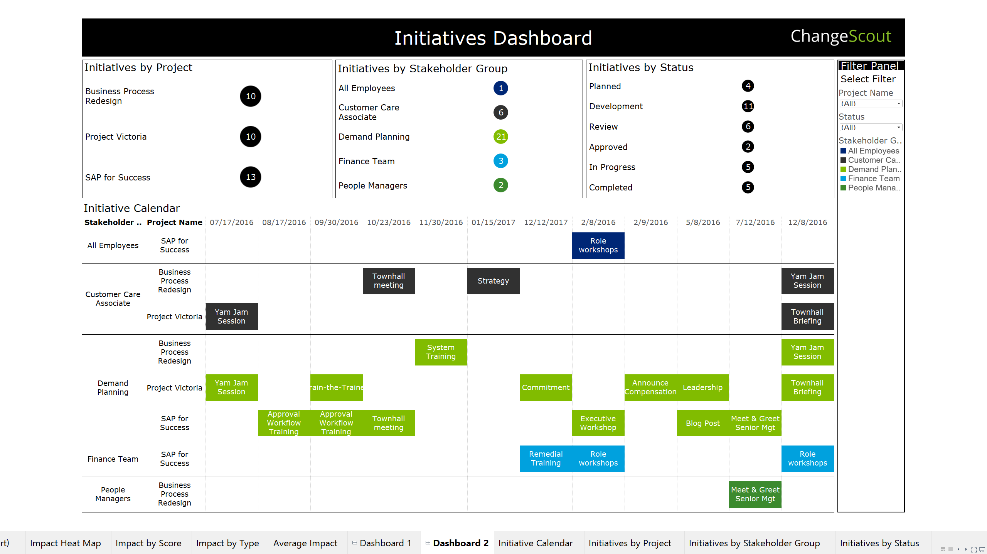
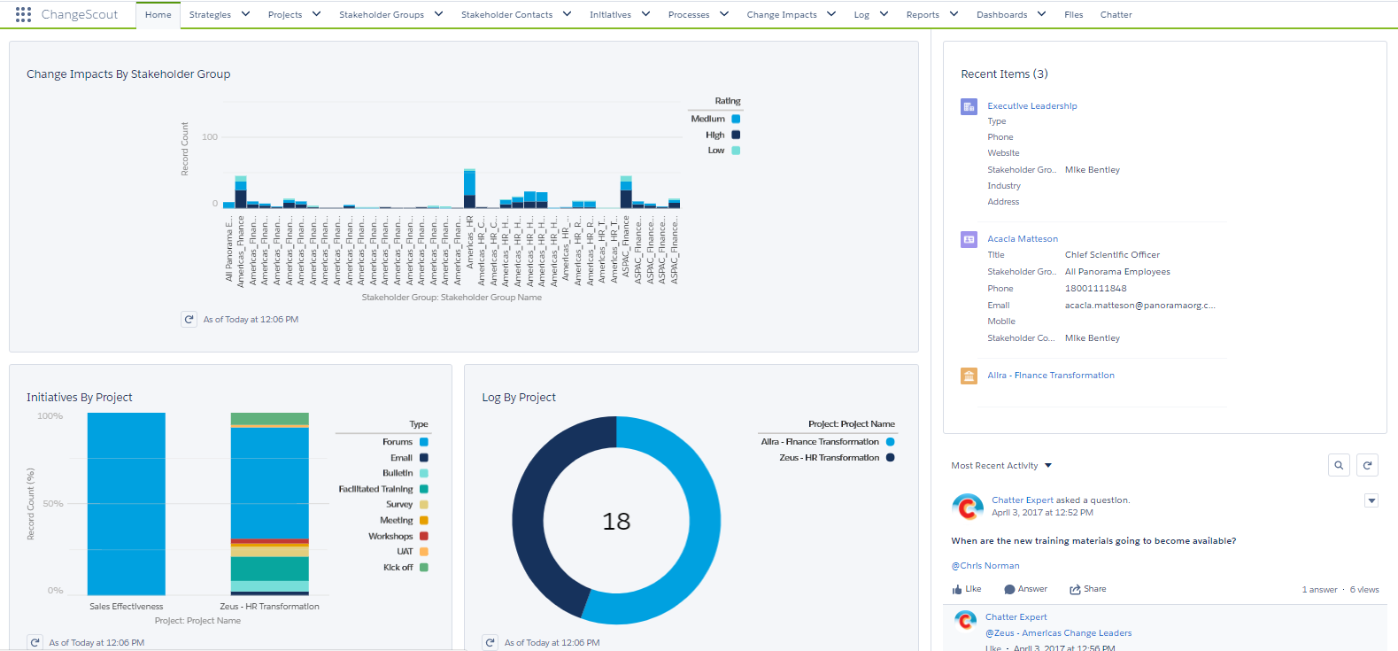
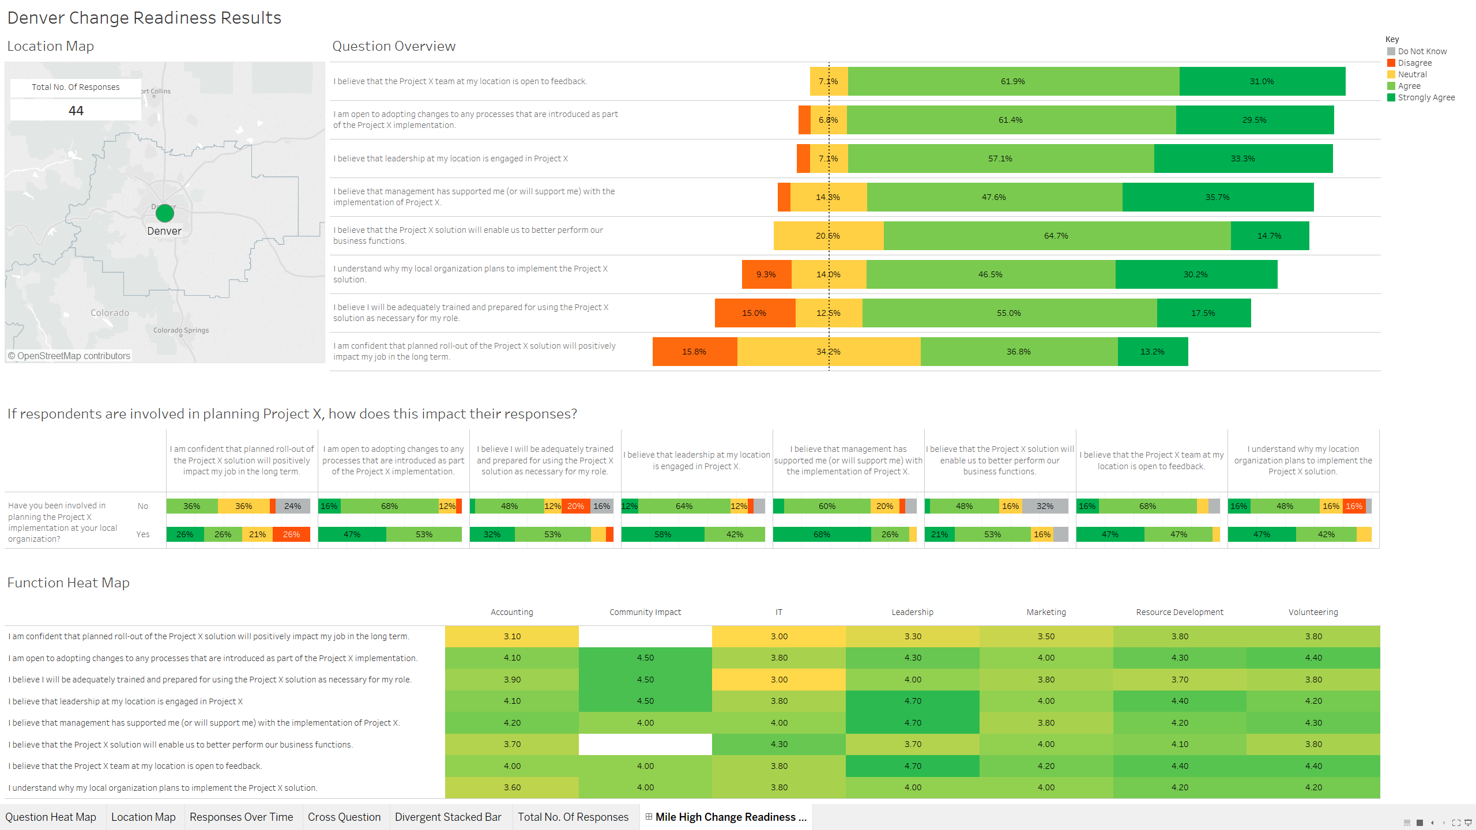
Technology Service Provider for Digital Transformation
1
2
3
4
5
6
7
Case Studies
8
Digital business model to enhance revenue and cut down cost while enhancing customer experience
Designing and Identify Digital business model to enhance revenue and cut down cost while enhancing customer experience
The Client wanted to enhance their customer experience and improve their outreach. to identify a digital business model, that would Enhance Revenue, cut down their costs; all the while prioritizing Environmental Health and Safety and good governance.
Phase -1
Phase - 2
Phase - 3
Assessed the digital maturity of business processes; mapped their issues and pain points
Assessed the IT Architecture, the IT Organization & capabilities
Defined business objectives and priorities ,Business imperatives, Future market evolution
Created a digital vision and mission through a Digital immersion workshop
Developed change readiness approach, tools and infrastructure
Mapped project charters with scope, efforts, timelines, high level costs and detailed business case
Short-listed 20 initiatives for implementation
Defined the platform design and architecture
Envisioned future state IT security landscape, the Future state of Digital/ IT organization & capabilities
Implemented strategy and roadmap
Designed Training curriculum and delivery approach
Setup the Digital factory
Program management and implementation of Pilot initiatives
Conducted training programs & evaluated their effectiveness
Implemented maintenance strategy, support and system implementation
Implementation of Initiatives like, Finalizing Min. viable offerings; roll-out plan; Setting-up initiative teams ;PMO support
On-boarding of the BPCL team; joint working for on-job training
Deploying Digital factory portal & uploading required documentation
Assessing & administering the additional trainings
Regularly assessing the reports and change effectiveness
Technical Health
Value Delivered
launched 13+ solutions to transform customer connect and customer experience.
Laid the foundation for single interface for BPCL customers and is now processing more than 20k LPG (propane bottle) orders every day; it Registered ~50k mechanics onto the platform who are encashing 20k cash coupons every day since launch.
A B2B ordering platform for industrial customers with 10k+ B2B indents placed.
Fleet and consumer loyalty with 120k+ fleet cards driving 20+% of diesel sales
Providing fleet owners and customers full control and visibility over spends and delivering loyalty benefits for the drivers and the owners.
A bespoke pre-paid voucher using native cloud components reducing payment time at retail outlets.

Slide 34



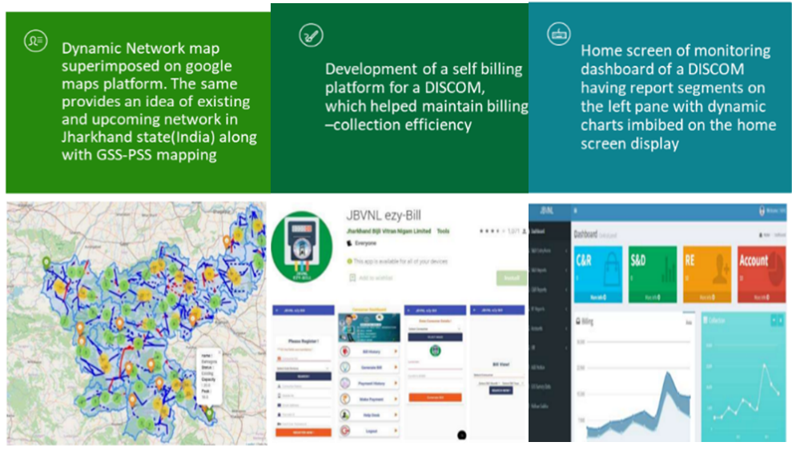
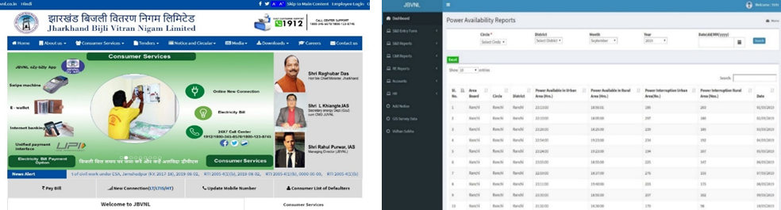
Information Management System for JBVNL
1
2
3
4
5
6
7
Case Studies
8
IT application development activities under the scope of Central Project Monitoring Unit
Assisting JBVNL in undertaking various IT application development activities under the scope of Central Project Monitoring Unit
Deloitte was responsible for commercial, revenue-related, and regulatory and energy-related MIS and strategic support. Key tasks included generating indicative MIS reports on metering, billing, and collection; division-ranking based on predefined KPIs such as consumer metering and billing efficiency; and generating division-wise reports on investment versus improvement in loss reduction. Additionally, circle-wise profitability reports are created with the goal of establishing each circle as a Profit Center, gradually extending this to the division and sub-division levels.
Scope of Work
MIS Dashboard development
Indicative MIS reports
Development and integration of 'Bulk Energy Bill Payment System' module in consumer Portal.
Development and web-integration of Live Feeder Tracking System.
Creation of PSS login, dashboard for Power Sub-Station
Development of applications like 'Know your Urja Mitra' and 'Consumer KYC updating’.
database migration of Rural Consumers from 2018 to 2021
Enhancing JBVNL website with various plug-ins and UI enhancement
Maintenance support to 'Suvidha', the New Connection Portal of JBVNL.
Indicative MIS Dashboard & Reporting
Regular collation and analysis of MIS-related data, aiding in document and presentation preparation for internal and external reviews, including central agencies.
Some of the modules that were covered:
Camp (New Connection, Modification, Bill Collection, Grievances), Feeder meter status, DT metering status , Theft, Online New Services connection, Complain management, CMS Website
Training and Development
Identification and suggestion of training themes for employees based on class and functions.
Formulation of training calendars and collaboration with partner training institutes.
Monitoring the program execution as per the established training calendar.

Slide 35
Enhancing Power Trading Efficiency
1
2
3
4
5
6
7
Case Studies
8
Implementing SAP-ERP System to Automate Processes and Facilitate Data Exchange for GRIDCO
Standard Feature, Functionalities and Reports of SAP applicable to GRIDCO's business function as identified and agreed for implementation during requirement study/AS-IS-TO-BE study phase.
Modules Implemented
Finance & Controlling Module (FICO)
Material Management Module (MM)
Sales and Distribution Module (SD)
Human Capital Management Module (HCM)
Capacity Building & Change Management
Ensured successful capacity building and smooth change management by flowing industry standard methodology. The exercise included the following:
Trainings
Standard functional training to functional and IT team.
Solution configuration training to functional and IT team
End user training to all users of GRIDCO for operation of software.
Technical training and system administration training to IT team.
Overview training of ABAP and BASIC to IT team
Go-Live & Stabilization
After successful migration following action were performed:
Demonstration of all modules with real-time and live data (Including master data) of GRIDCO.
Perform stabilization testing for a week.
Post implementation support after end of stabilization period.
Hosting & Deployment
The software solution was hosted on-premises designated data center of GRIDCO.
Develop and customized the software as per the requirement of GRIDCO in its own hosting infrastructure/cloud infrastructure.
Document Management System
All the modules were integrated with Document Management System available in SAP S4 HANA to effectively manage and maintain official documents of GRIDCO.

Slide 36

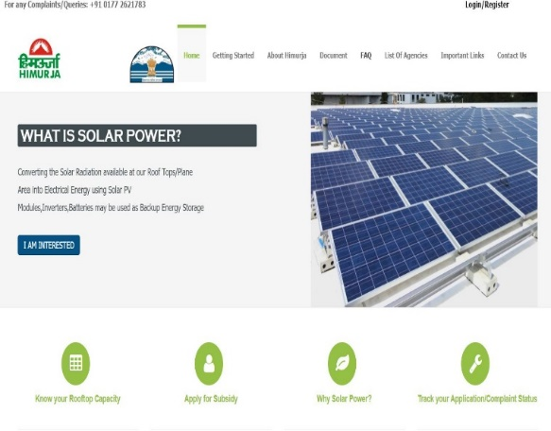
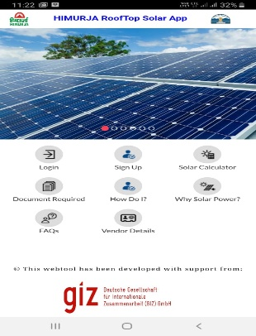
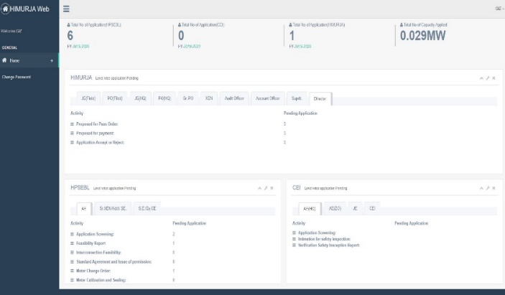
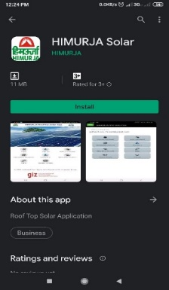
1
2
3
4
5
6
7
Case Studies
8
Himurja Roof Top Solar Application (Single Window Clearance System)
Data Analytics Platform Implementation
Implementation of Data Analytics Platform for Bureau of Indian Standards (BIS)
Deloitte was appointed by GIZ to assist Himurja (Himachal Pradesh) in the operation, testing and stabilization of the Roof Top Solar (RTS) portal
Deloitte was also appointed to develop institutional capabilities within Himurja and other state agencies for effectively managing engagement of consumers into the RTS portal.
The portal has been live since April 2019.
Along with assistance in the stabilization and enhancement of portal, Deloitte developed the mobile application for Himurja officers.
We also undertook troubleshooting and update of web based RTS portal based on feedback from Himurja.
Resolution of safety issues pursuant to security audit and training to Himurja officials on operation of the portal was also provided.
RTS Portal
Himurja solar mobile app
Dashboard
Google Play Store

Slide 37
| Partner Profiles
Deloitte brings a pool of experts with extensive experience in the Power Utilities and Renewables sector, offering comprehensive solutions to address the industry's unique challenges and opportunities.

Slide 38



Our Team
1
2
3
4
5
6
7
8
Partner Profiles
Dynamic and experienced group of professionals dedicated to providing exceptional services and solutions in PU&R
Shubhranshu Patnaik
Core Business Operation Leader
Contact: spatnaik@deloitte.com
Anujesh Dwivedi
Partner – Power & Utilities
Contact: anudwivedi@deloitte.com
Amitabh Saha
Partner – Power & Utilities
Contact: amitabhsaha@deloitte.com

Slide 39
Deloitte refers to one or more of Deloitte Touche Tohmatsu Limited (DTTL), its global network of member firms, and their related entities (collectively, the “Deloitte organization”). DTTL (also referred to as “Deloitte Global”) and each of its member firms and related entities are legally separate and independent entities, which cannot obligate or bind each other in respect of third parties. DTTL and each DTTL member firm and related entity is liable only for its own acts and omissions, and not those of each other. DTTL does not provide services to clients. Please see www.deloitte.com/de/UeberUns to learn more.
Deloitte provides industry-leading audit and assurance, tax and legal, consulting, financial advisory, and risk advisory services to nearly 90% of the Fortune Global 500® and thousands of private companies; legal advisory services in Germany are provided by Deloitte Legal. Our professionals deliver measurable and lasting results that help reinforce public trust in capital markets, enable clients to transform and thrive, and lead the way toward a stronger economy, a more equitable society and a sustainable world. Building on its 175-plus year history, Deloitte spans more than 150 countries and territories. Learn how Deloitte’s approximately 457,000 people worldwide make an impact that matters at www.deloitte.com/de.
This proposal has been solely prepared for the internal use of the company/companies named in the proposal. Any disclosure to third parties – in whole or in part – is subject to our prior written consent.

Slide 40
Key Offerings across Power & Utility Segment
1
2
Our Offerings
3
4
5
6
7
8
We focus to address critical challenges impacting country performance, economic competitiveness, and citizen service
DIGITALIZATION
MARQUEE PROJECTS
PROCESS BIONICS
Regulatory Information Management System (RIMS)
USAID Urja Nepal
DVC
Business Process Reengineering
Generation Expansion Planning Tool
Demand Forecasting Tool
Least-Cost Capacity Expansion Models (IRP)
Network Studies
Project Monitoring Tools
Enterprise Architecture Evaluation
Integrated Resource & Resilience Planning (IRRP)
Project Prioritization Tool
Business Process Reengineering
ERP Implementation
AVEVA PI System
ERP Readiness Evaluation
EV & E-Cooking Grid Impact Assessment
Change Management & Capacity Building
Tariff & Regulatory Support
IT Infrastructure Evaluation
ENERGY TRANSITION
POWER PURCHASE
RESOURCE PLANNING & NETWORK MODELLING
Implementation Support of ERP systems
Policy and Regulatory Framework Development
Renewable Energy Integration
Short Term Power Purchase
Demand Forecasting
Generation Expansion Planning
Development of Data Analytics Platforms and Dashboards
Financial Modelling and Economic Analysis
Energy Efficiency & Demand Management
Scheduling and Dispatch Optimization
Load Flow Studies
Integrated Resource and Resilience Planning

